Slide 1
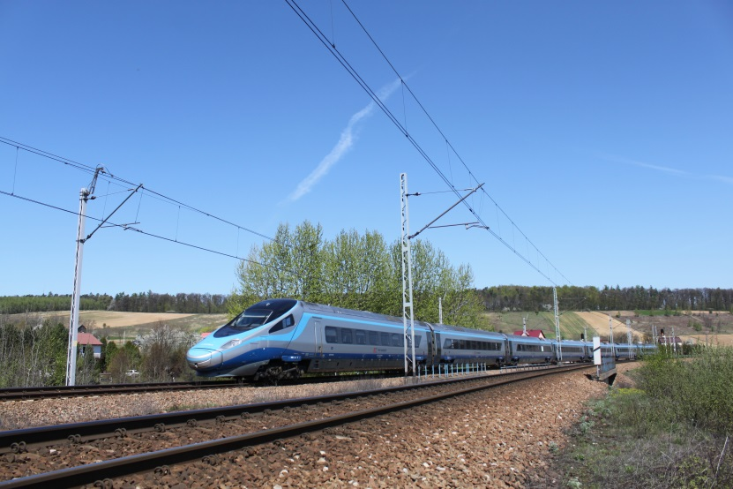
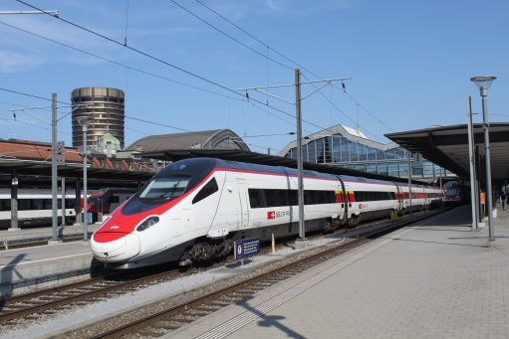
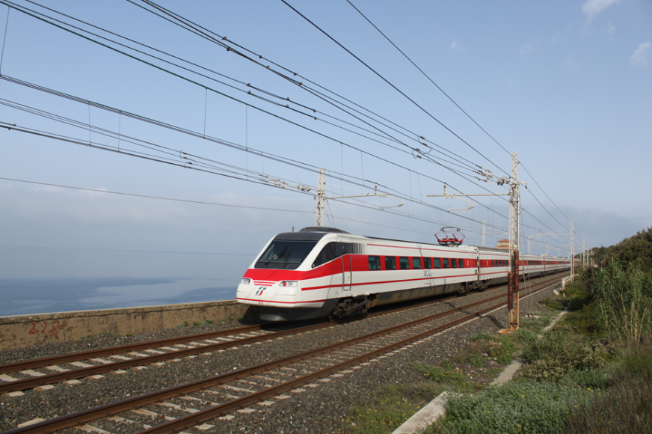
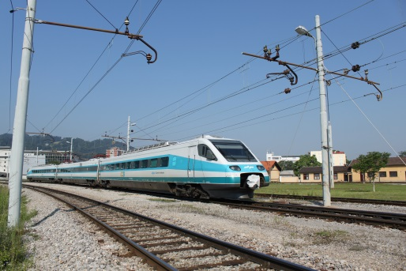
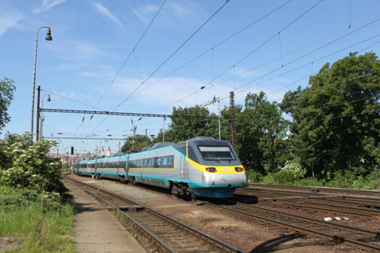
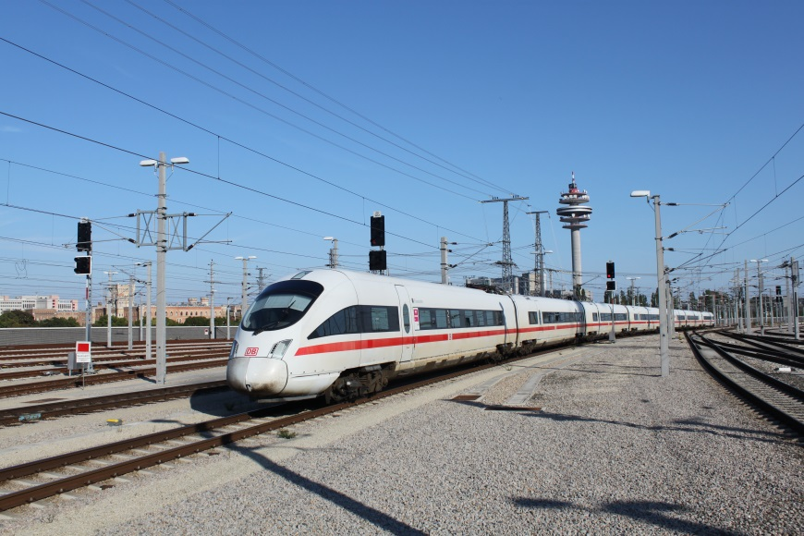
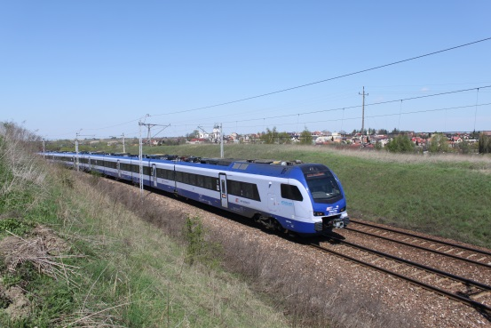
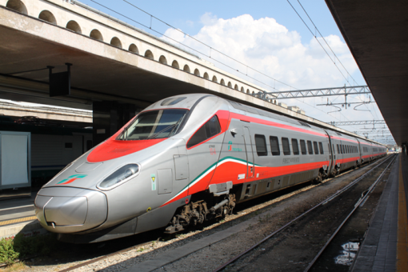
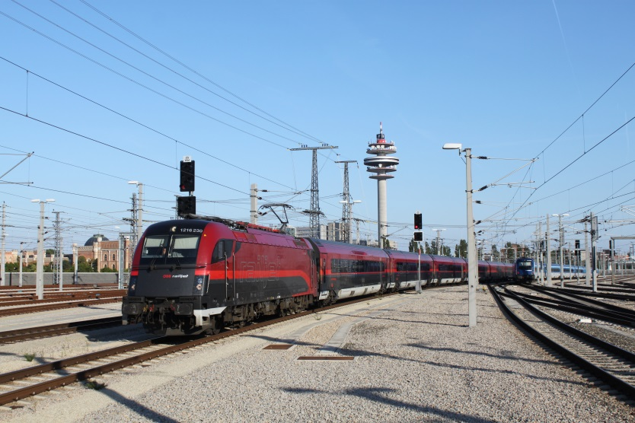
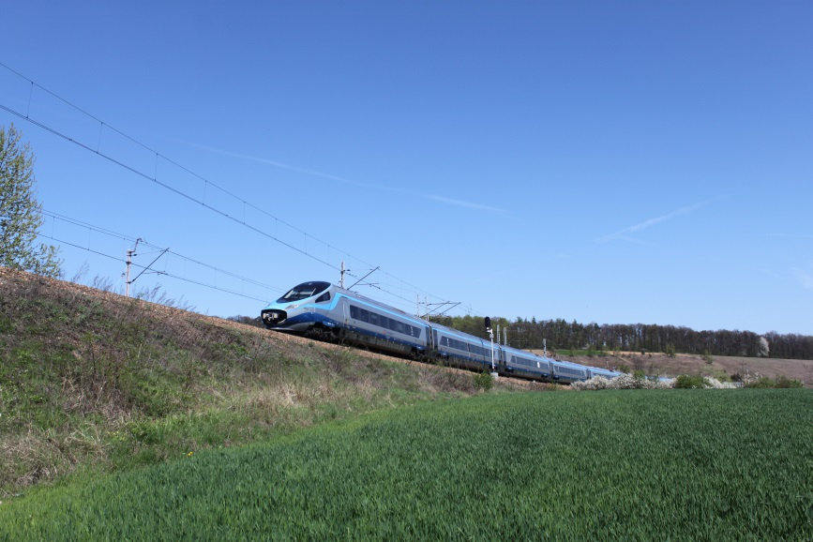
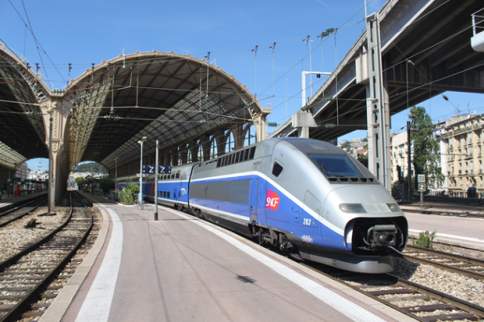
High speed railways in Poland – a political playground or a real need? The advisability of constructing a HSL system in a medium-sized country in Central Europe
Marcin Król
Warsaw School of Economics (SGH)
Jakub Taczanowski
Jagiellonian University, Kraków

Slide 2
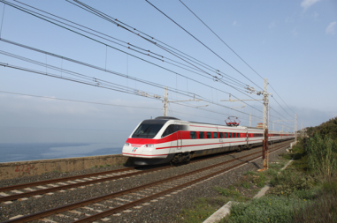
High speed railways
High speed rail includes a complex reality involving various aspects:
Technical: infrastructure, rolling stock and operations
Cross-sector: financial, commercial, managerial and training issues (UIC)
High speed railways comprise:
Specially built High Speed lines equipped for speeds generally equal to or greater than 250 km/h
Specially upgraded High Speed lines equipped for speeds of 200 km/h
Specially upgraded High Speed lines which have special features as a result of topographical, relief or town-planning constraints, on which the speed must be adapted to each case (European Commission directive 96/48/EC appendix 1)

Slide 3
Poland – the first European country with HSL?
Central Rail Line (Polish: Centralna Magistrala Kolejowa, CMK)
(Warsaw-) Grodzisk Maz. – Psary (-Kraków) - Zawiercie (-Katowice)
Total length 223 km
Construction 1971-77
(opening of the first section of the Direttissima Rome – Florence 24.02.1977 , TGV Paris – Lyon 22.09.1981)
However
The first express train 3.06.1984 (140 km/h),
160 km/h from 1988,
200 km/h from14.12.2014
Technical parameters:
Maximum passenger train speed: 200-250 km/h
Minimum curve radius: 4000 m
Steepest gradient: 6 per 1000

Slide 4
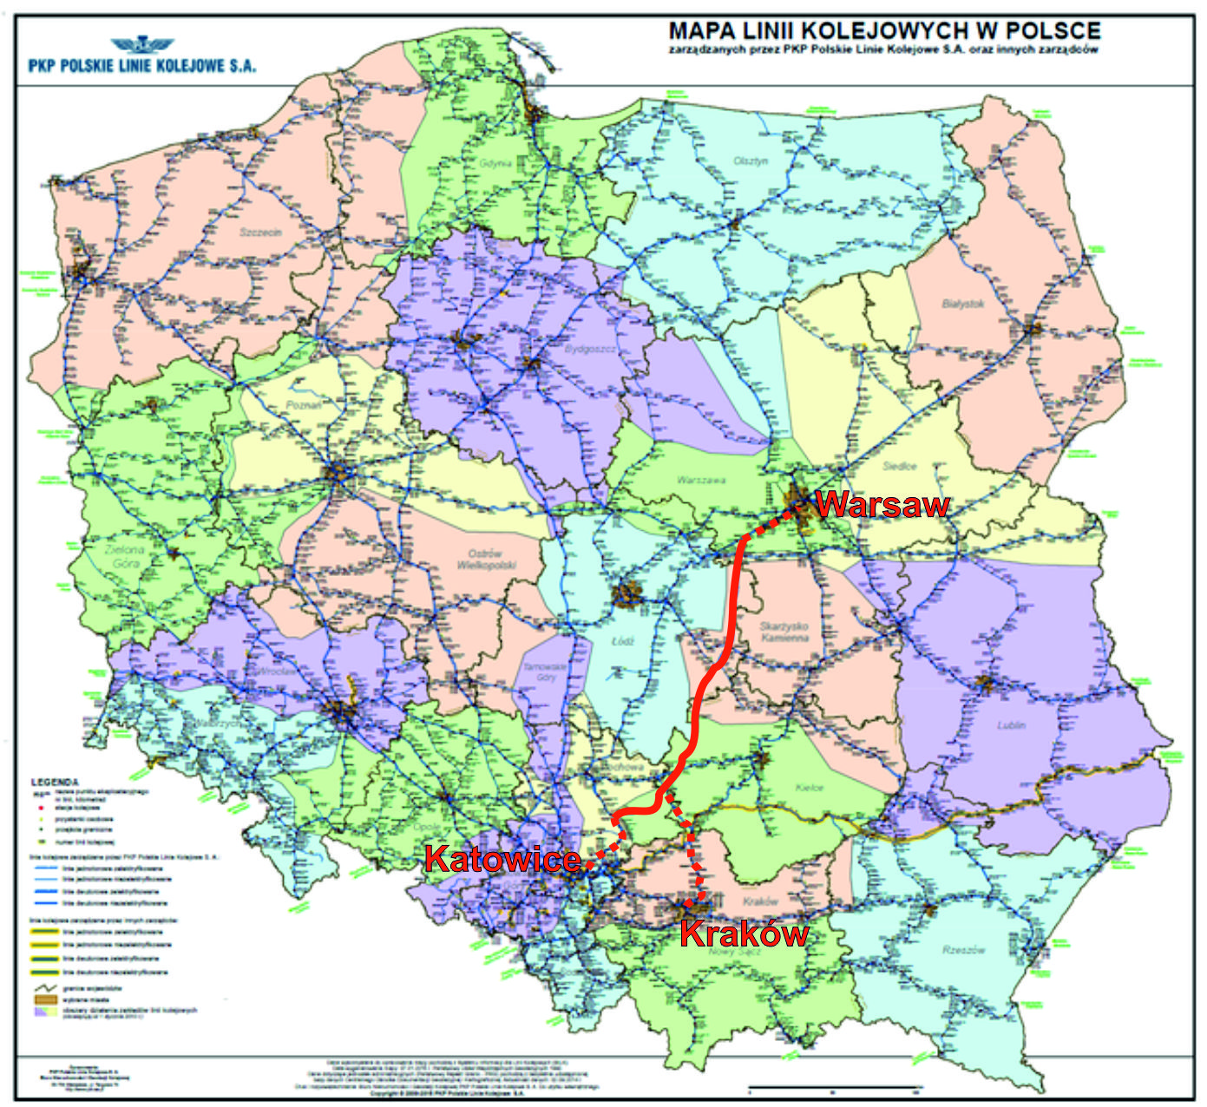
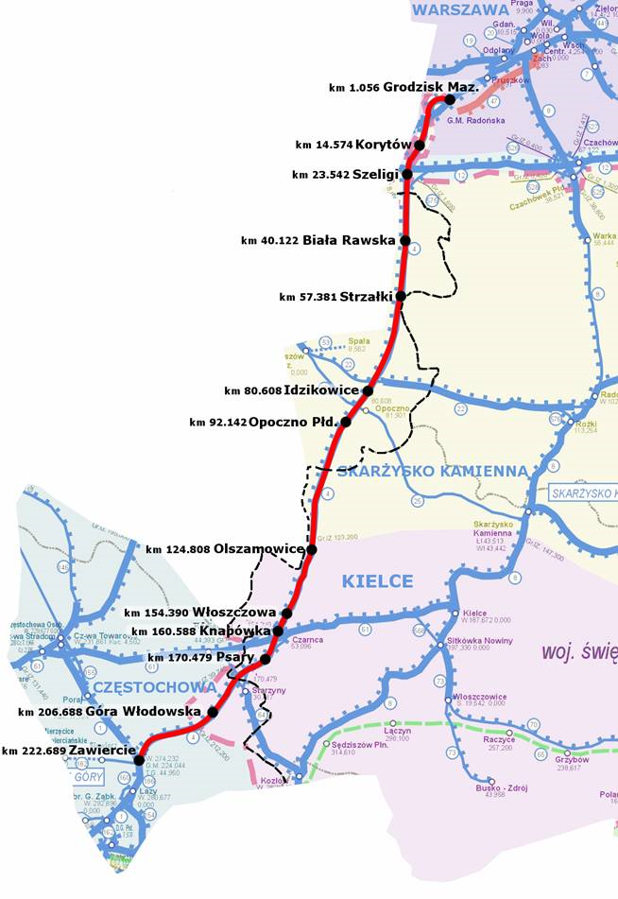
Central Rail Line
Source:
author’s own elaboration on the basis of: www.plk-sa.pl.
Source: www.siskom.waw.pl.

Slide 5
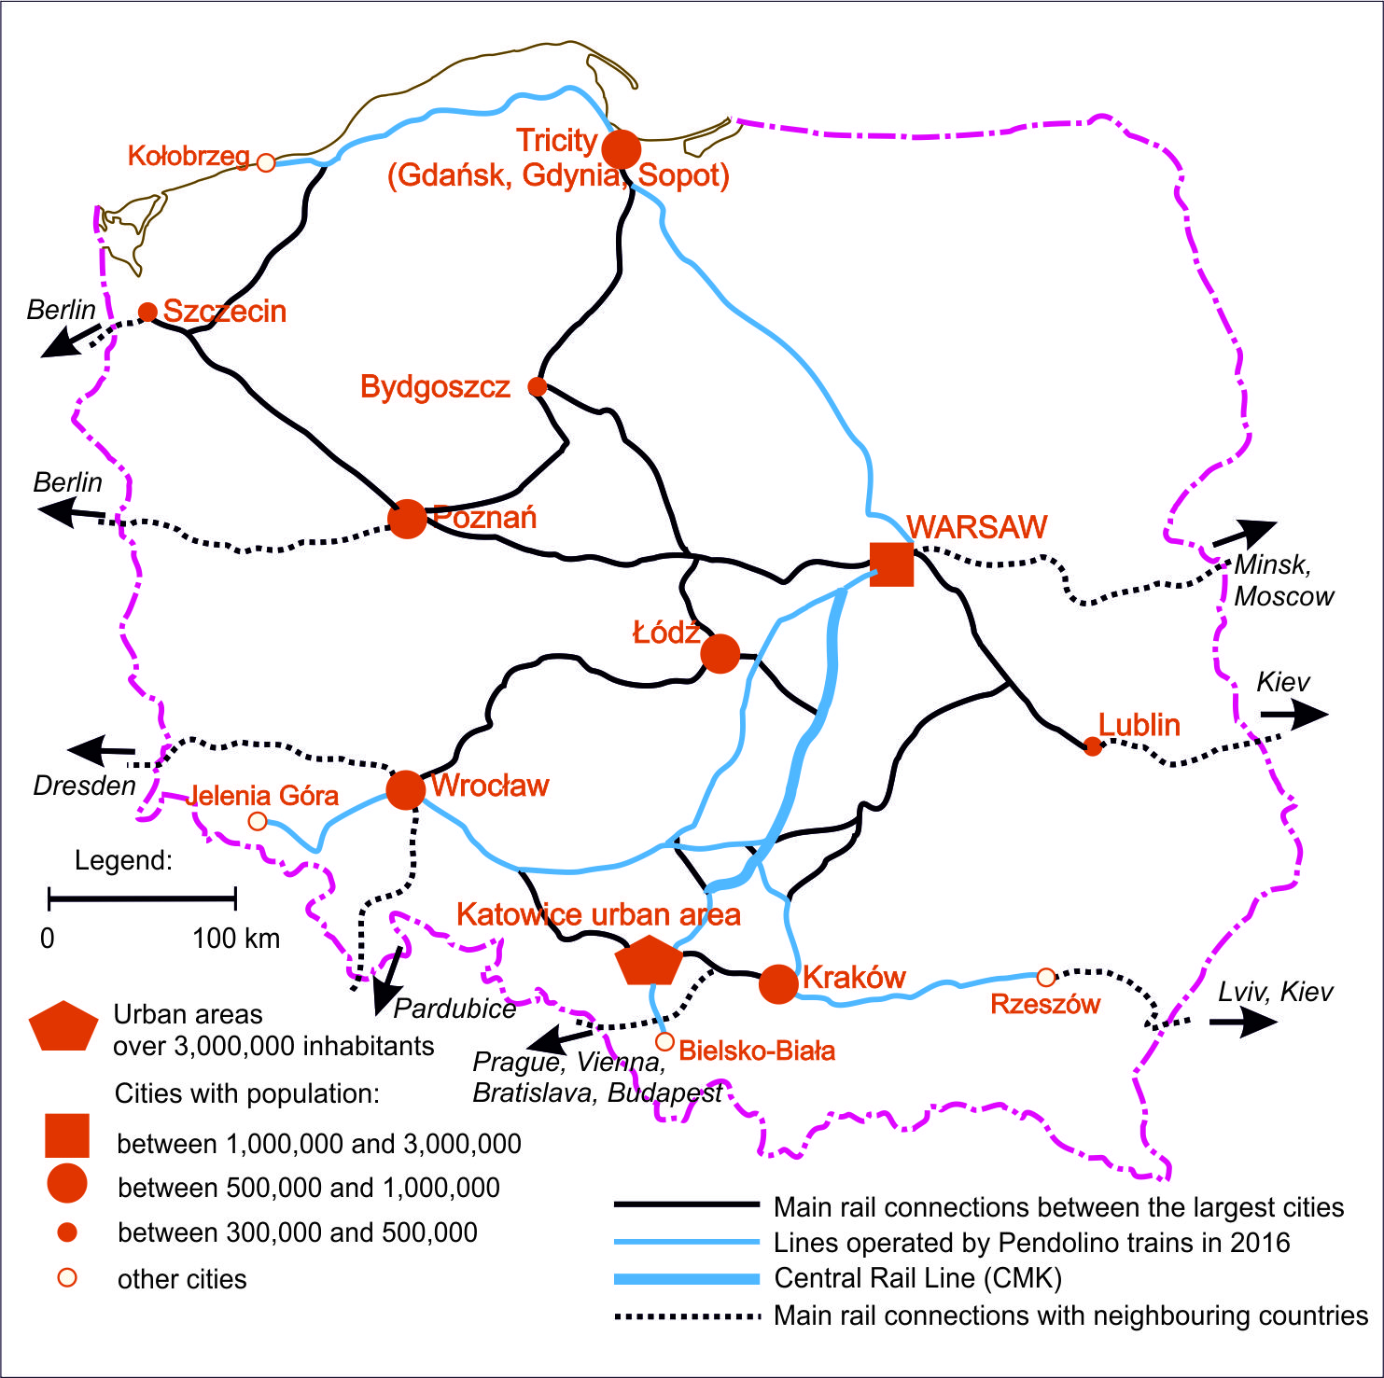
Main rail connections in Poland
Source: author’s own elaboration.

Slide 6
Pendolino trains in Poland
May 1994 – presentation of the ETR 460 train in Poland and high speed trials on the Central Rail Line (CMK) 11.05.1994 – Central-European speed record of 250,1 km/h was reached
1997 – the first tender for fast trains with tilting mechanism
1998 – FIAT Ferroviaria was declared the winner, but the Supreme Audit Office (NIK) cancelled the tender because of the poor financial situation of the PKP and lack of suitable infrastructure
2008 – the second tender, this time for high speed trains without tilting mechanism
2010 – Alstom was declared the winner
2013 – arrival of the first of 20 ED 250 trains
24.11.2013 – a new speed record was broken on the CMK (293 km/h)
14.12.2014 – beginning of the commercial use

Slide 7
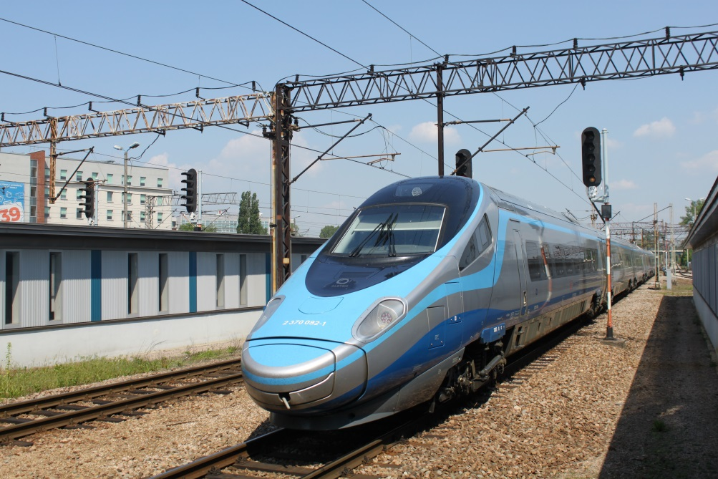
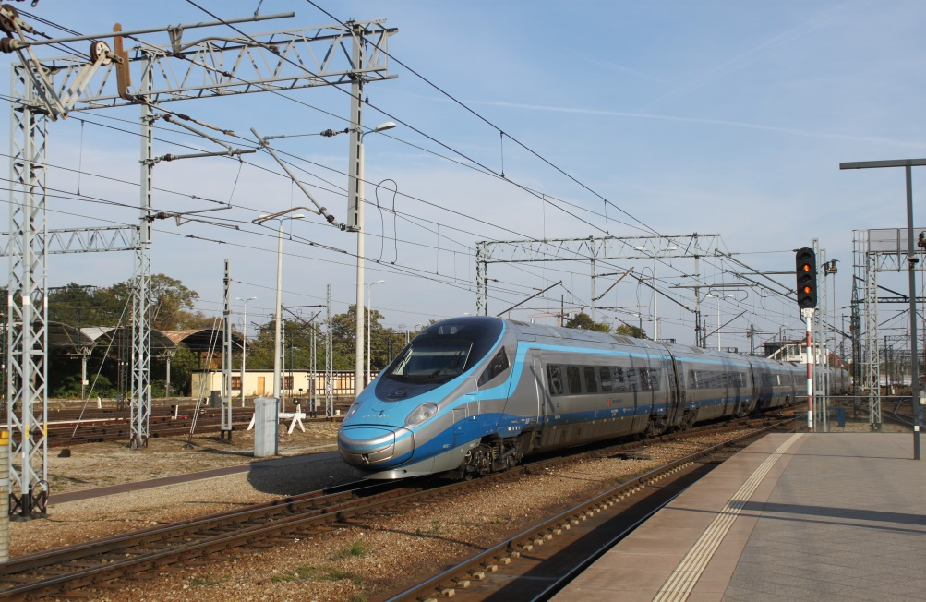
Photo Jakub Taczanowski

Slide 8
The rise of domestic rolling stock producers
PESA in Bydgoszcz
Founded as Prussian railway workshops in 1851
2001 – new name and profile: rolling stock construction and not only repair and modernisation
2001 – the first producer of modern railway motor carriages in Poland
2004 – construction of the first electric units
2006 – the first contract to Western Europe (Italy)
2012 – the beginning of production of electric locomotives (Gama)
2012 – contract for 470 diesel units for DB for 1.2 billion euro
2014 – the first long-distance electric units Dart with maximum speed of 200 km/h; 30.05.2015 – the speed record of 204 km/h was broken
NEWAG in Nowy Sącz
Founded as Austrian railway workshops in 1876
2005 – new name and beginning of production of electric units
29.08.2015 – speed record of rolling stock designed and constructed in Poland was broken by 45WE Impuls electric unit - 225,2 km/h

Slide 9
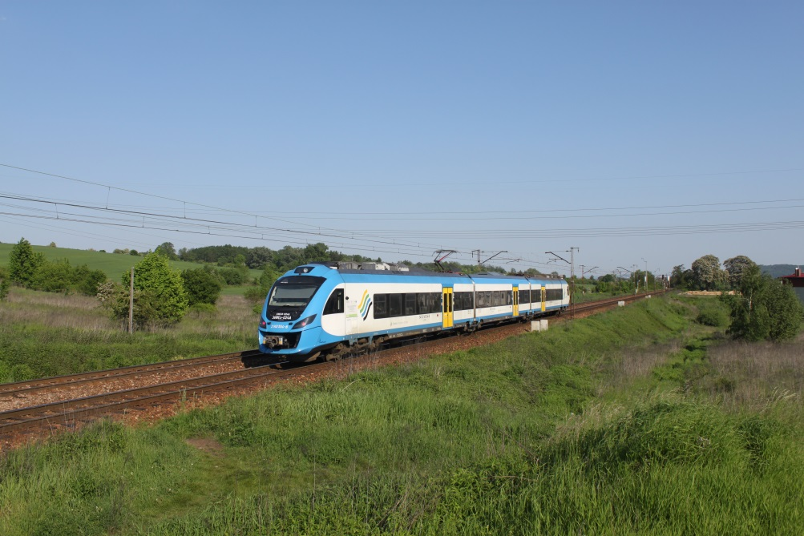
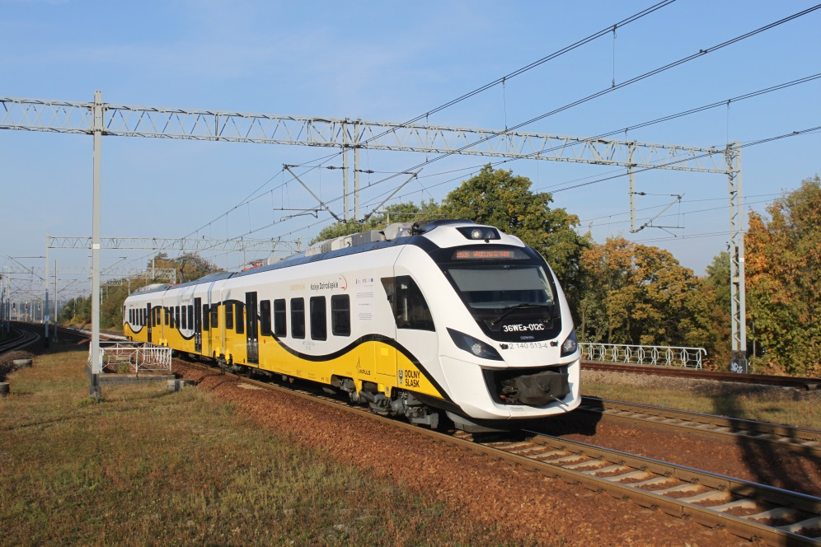
NEWAG 36 WE Impuls
Photo Jakub Taczanowski

Slide 10
The recurring project of „Y” HSL
Basic characteristics:
A completely new railway line from Warsaw to Poznań and Wrocław
The old problem of the long Warsaw-Wrocław line – solved
Central position of Łódź (with a new underground railway station)
Total length of about 450 km
Maximum speed of 350 km/h
25 kV AC electrification system (not used in Poland so far)
History:
2008 – PKP PLK S.A. launched a tender for a feasibility study
2010 – The agreement on feasibility study was signed with the winner
2011 – The minister of transport decided to postpone the project until 2030
2014 – Poland applied for the European Commission grants for transport, the „Y” HSL was included with the total cost of 7.5 billion euros
2014 – a contract for a feasibility study to prolong the „Y” HSL to Prague and Berlin was signed

Slide 11
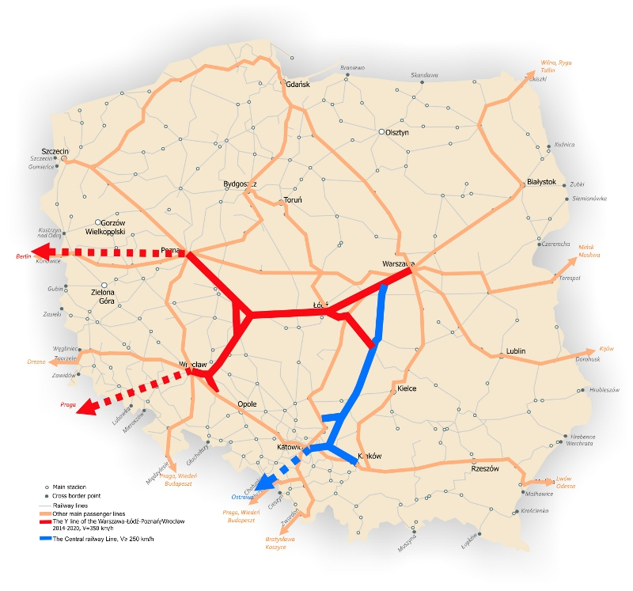
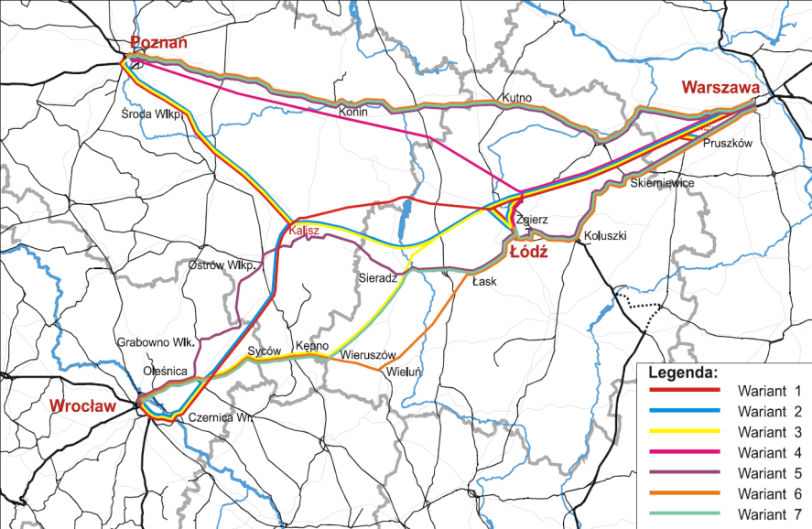
The recurring project of „Y” HSL
Source: PKP PLK S.A .
Source: www.siskom.waw.pl .

Slide 12
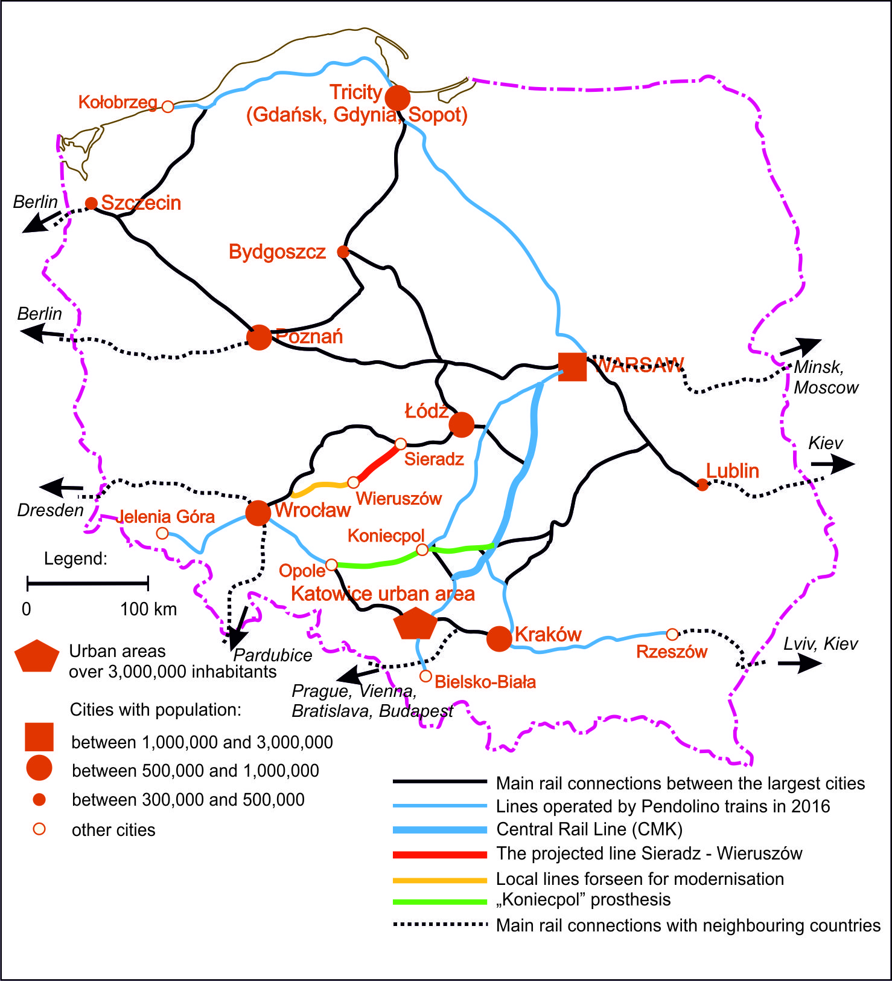
Alternative projects for Warsaw – Wrocław route
Sieradz – Wieruszów line:
A completely new railway line from Sieradz to Wieruszów (49 km)
Electrification and modernisation of 45 km of local lines
Costs about 1.3 billion zł
Project abandoned in favour of the „Koniecpol prosthesis”
„Koniecpol prosthesis”:
Modernisation of the line Koniecpol – Opole (136 km) in order to reach a speed of 120-140 km/h
A less expensive alternative to „Y” HSL
The first Pendolino train in 2014
Source: author’s own elaboration.

Slide 13
Journey times
Warsaw – Kraków line (Central Rail Line, 293 km)
Transport mode | Journey time
Pendolino train | 2 h 20 min
Airplane | 0 h 55 min + transfer (2h)
Bus | 4 h 55 min
Private car | 4 h 07 min
Warsaw – Wrocław line (397 km down the „Koniecpol prosthesis”)
Transport mode | Journey time
Pendolino train | 3 h 42 min
„Y” high speed train | 1 h 40 min
Train via new Sieradz line | 2 h 30 min
Airplane | 0 h 55 min + transfer (2h)
Bus | 5 h 30 min
Private car | 3 h 41 min
Source: author’s own elaboration based on: www.intercity.pl; http://inforail.pl; www.e-podroznik.pl and google.pl

Slide 14
Financial sustainability considerations: Track access charges

Slide 15
Financial sustainability considerations: Fares

Slide 16
Earnings disparity

Slide 17
SWOT analysis for HSL
Strenghts | Weeknesses
Central Rail Line Pendolino trains A project of „Y” HSL Warsaw-Poznań/Wrocław | Little experience in HSL construction Controversies around „Y” HSL (project officially postponed until 2030 in 2011) The general organisational and financial situation of the PKP „Group”
Opportunities | Threats
Compact state territory Air travel (bird fly) distance between Warsaw and all cities and urban areas over 300,000 is not larger than 300 km (the only exception is Szczecin, 450 km) An important southern urban axis Wrocław – Katowice – Kraków – Rzeszów with the total urban population over 5,000,000 Location at the „cross-roads” of Traneuropean railway lines Rise of the Polish rolling stock producers – PESA and NEWAG | Large-scale neglects in the existing railway network of the country The decreasing role of the railways in the Polish transport system The general poor image of the railways in the conutry The risk to block all investments in the rail infrastructure by launching the HSL project Competition of low-cost long-distance bus companies Low-cost domestic flights
Source: author’s own elaboration.

Slide 18
Discussion
HSL project would be a completely new challenge for the PKP
Very high construction costs could block all other investments - not only in projected new lines (mainly connections with airports) but also maintenance of the existing network
HSL maintenance costs are particularly high – do we know anything about the chances to cover them in the long run - > rentability of HSL
How much are the potential customers ready to pay for shorter journeys? What is the price of time for Polish citizens?
HSL as a chance for the Polish railways and rolling stock manufacturers to leapfrog to the future?
HSL as a chance to boost the Polish economy

Slide 19
Conclusions
It is very difficult to evaluate the advisability of constructing a HSL in Poland
The potential opportunities are balanced by several significant threats and risks
Given the state of the railway infrastructure and rail transport in general, our intuition is to concentrate on the existing network by developing its potential (e.g. modernisation to the maximum speed of 200 km/h in the case of Warsaw-Poznań or fragments of Warsaw-Gdańsk lines) and by purchase of modern rolling stock (also from Polish manufacturers)
Should the HSL project be treated as a very important next step in Polish railways development?

Slide 20
Thank you for your attention!

