Slide 1
Rail Reform – Czech Experience Zdeněk Tomeš – Martin Kvizda – Tomáš Nigrin – Daniel Seidenglanz – Monika Jandová – Václav Rederer

Slide 2
Summary
Introduction
Passenger traffic
Case study: Open access on Prague – Ostrava route
Freight traffic
Conclusions

Slide 3
Czech railway reform
Vertical separation of the industry in 2003
Horizontal integration of passenger and freight operation of the state-owned incumbent České dráhy
Competition entry of many small private operators

Slide 4
Vertical separation
1993 – 2002 → vertical integration of infrastructure management and provision of services
1.1.2003 → vertical separation (partial); the emergence of the independent infrastructure manager (SŽDC) and the incumbent operator České dráhy (ČD)
2003 – 2008 → infrastructure maintenance and timetabling still done by the incumbent ČD
2003 – 2011 → traffic control performed by ČD
2003 – 2015 → ČD possess railway stations

Slide 5
PASSENGER TRAFFIC

Slide 6
Railway passenger traffic - statistics
 | 1995 | 2000 | 2006 | 2010 | 2013
Passenger- Kilometers (billions) | 8.0 | 7.3 | 6.9 | 6.6 | 7.6
Modal Share of Railways (%) | 10.8 | 8.3 | 7.5 | 7.5 | 8.5
Private Operator’s Market Share (%) | n.a. | n.a. | 0.15 | 0.2 | 5.1

Slide 7
Density of passenger rail traffic
Source: ČD, 2009

Slide 8
Long distance x regional passenger traffic
Long distance
express, intercity and supercity connections of main cities.
subsidized by the Ministry of Transport
competition organization:
1) open access (Prague – Ostrava)
2) competitive tendering (3 routes at present)
3) direct awarding (rest of the network)
Regional
regional and commuter trains for shorter distances
subsidized by regional authorities
competition organization: direct awarding of all subsidized services to the incumbent for the period 2009-2019

Slide 9
Challenges
Pros and cons of open access
Competitive tendering still little used
Infrastructure investments:
Speed limits due to bad condition of infrastructure
Main corridors x regional lines
Does HSR Praha – Brno make sense?

Slide 10
CASE STUDY: OPEN ACCESS PRAHA - OSTRAVA

Slide 11
History
Before 09/2011 → high density of traffic, low intermodal competition, high fares, low quality of ČD coaches, subsidies, no competition
09/2011 → withdrawal of public subsidies; the open access entrance of the first private competitor RegioJet
01/2013 → the entrance of the second private competitor LeoExpress
2012 - 2015 → intensive competition of three operators

Slide 12
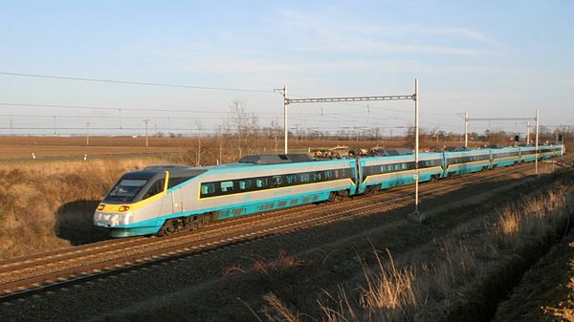
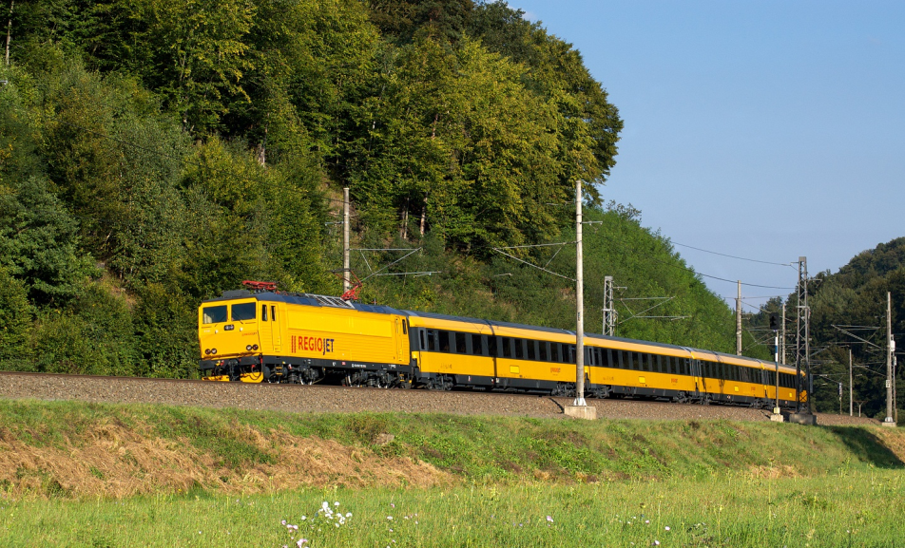
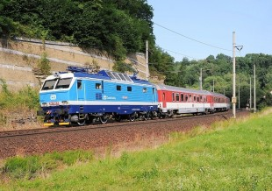
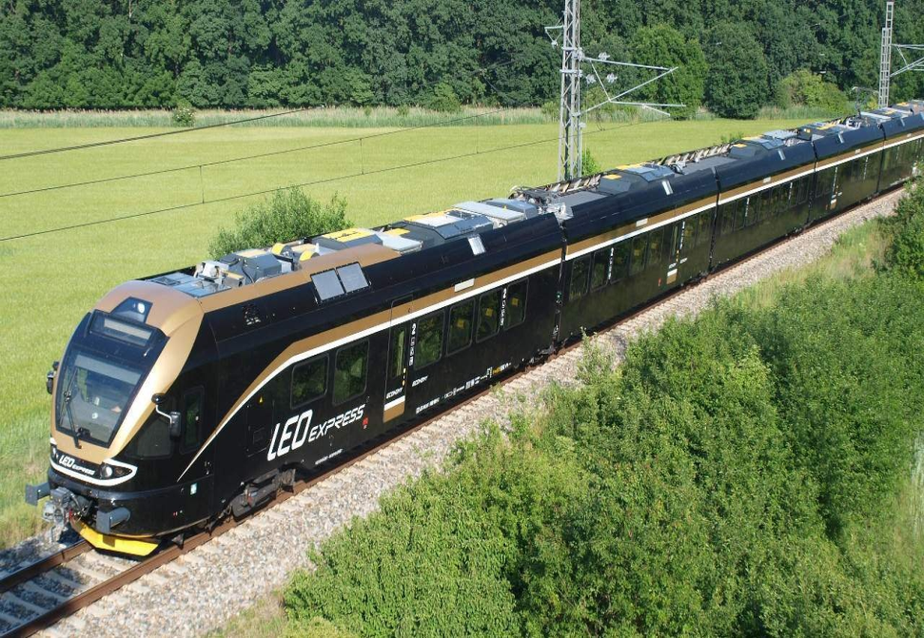
Service differentiation

Slide 13
Prices (CZK)

Slide 14
Profits (mil. CZK)
 | 2012 |  | 2013
 | Revenue | Profit | Revenue | Profit
České dráhy | 19 500 | -517 | 19 900 | -1 795
RegioJet | 246 | -76 | 318 | -93
LEO Express | 7 | -76 | 158 | -159

Slide 15
Frequency of services (daily)

Slide 16
Capacity
 | 2010 | 2011 | 2012 | 2013 | 2014
Average Number of Coaches Per Train | 8.9 | 7.2 | 7.3 | 7.0 | 6.7
Average Number of Seats per Train | 465 | 408 | 353 | 336 | 333
Total Daily Capacity (Number of Seats) | 10 687 | 12 649 | 11 282 | 13 437 | 11 650

Slide 17
Demand (mil. pass-km per day)
 | ČD SC | ČD IC | RegioJet | LEO Express | TOTAL
2010 | 1.1 | 1.9 | - | - | 3.0
2013 | 0.7 | 1.2 | 1.6 | 0.7 | 4.2
(mil. pass-km per day)

Slide 18
Infrastructure capacity

Slide 19
From tact to demand derived timetable
Number of Passenger Trains Departing from Ostrava to Prague on Weekdays (number of trains per hour)

Slide 20
Assessment
+ better quality of services
+ higher frequency of trains
+ lower prices for customers
all competitors unprofitable
weak regulation
no tariff integration
strains on infrastructure capacity

Slide 21
FREIGHT TRAFFIC

Slide 22
Railway freight traffic - statistics
 | 1995 | 2000 | 2006 | 2010 | 2013
Tonne- Kilometers (billions) | 22.6 | 17.5 | 15.8 | 13.8 | 14.0
Modal Share of Railways (%) | 41.6 | 31.9 | 23.8 | 21.0 | 20.3
Private Operator’s Market Share (%) | n.a. | n.a | 5.4 | 13.2 | 23.7
¹2006

Slide 23
Freight challenges
The incumbent is losing the most lucrative customers to private competitors.
The incumbent’s freight division is slow reacting, under-invested and over-employed.
Possible solution → horizontal separation of passenger and freight operation of the incumbent and privatization of the freight division.

Slide 24
Conclusions
Slow reform; the incumbent still owns railway stations.
Dynamic evolution of open access competition on the Prague - Ostrava route. The capable regulator is missing to solve many emerging competition disputes.
With the exception of the Prague – Ostrava route, all other passenger traffic is subsidized and in most cases directly awarded.
Possible solution to weak performance of freight traffic could be privatization of freight division of the incumbent.

