Slide 1

Wider economic impacts – Can HSR rebalance regional economies?
Prague Conference on High-Speed Rail
Roger Vickerman
Notes:
V1.0
To change the footer on every slide:
1. On the menu go to Insert > Header and Footer…
2. Select the Footer checkbox and enter the footer text in the accompanying text box
3. Click “Apply to All”

Slide 2
Introduction and motivation
High-speed rail is claimed to have a transformative effect on local economies.
Better connectivity and lower transport costs lead to enhanced growth and productivity.
But are such effects just redistributive: some regions benefit whilst others suffer
Here we examine the claim that step changes in transport provision can lead to major changes in economic structure that can transform regions’ absolute as well as relative positions
Such claims of economic transformation have been made for HS2 in the UK
We look at the theory behind this, at evidence from France and HS1 in Kent
The main conclusion that transport infrastructure by itself is not likely to be transformative, but coupled with other policy interventions it can contribute to such an effect

Slide 3
Transport and the economy
The multiple nature of transport
  Transport as a derived demand
  Transport as a substitutable input
  Transport as an engine of growth
The role of accessibility and speed
  Accessibility: distance, speed and frequency
  External accessibility and the ‘two-way’ road
  Internal accessibility and efficiency
Accessibility, the cost of transport and economic growth
  If transport costs are reduced industries become more competitive
  Improved transport contributes to productivity growth.
  Changes in the location of activities
  Employment growth

Slide 4
The agglomeration issue
From accessibility to agglomeration
  Transport costs as determinant of the price of an urban location
  And hence of the real wage
  Thus going beyond the simple value of time savings as a transport benefit
The theoretical basis of agglomeration
  Increasing returns, transport costs and market size
  Linkages in the local economy
  The role of real wages in cumulative causation
  Labour market impacts

Slide 5
CBA: the standard approach
Generalised
Cost
C
C’
D
Q Q’
Volume

Slide 6
CBA: the standard approach
But what are the assumptions lying behind this?
  Perfect competition so that p=mc
  No externalities so that mc=smc
  No returns to scale so mc constant
  Demand is only responsive to a change in price, not a change in supply (i.e. a fixed trip matrix)
Suppose we change these assumptions
  mc is upward sloping and smc>mc
  But with increasing returns mc could slope down
  p≠mc
  And D could shift outwards in response to changing opportunities
  But suppose that agglomeration also caused mc to shift downwards
  Is the outcome now so determinate?

Slide 7
A theoretical model of labour market benefits from transport improvement
δ
β
α
γ
Source: Venables (2004)

Slide 8
How do we measure these effects?
Methodology well developed for urban applications: Wider Economic Impacts (WEI)
  Based on impacts on labour markets of improved accessibility
  Effective density, agglomeration and productivity
  The Crossrail example
Less well developed for inter-urban applications
  Can we apply the labour markets approach?
  Is there something else?
Concern about centralisation – do all the benefits go to the biggest city?

Slide 9


Measuring wider impacts
Labour supply and productivity
Output change in imperfectly competitive markets
Agglomeration – effective density, economic mass and productivity

Slide 10
From economic mass to connectivity
Economic mass relies on continuous measures of distance/time
HSR is not continuous: differential impacts on regions and within regions
Need to understand how changes from HSR affects the way businesses connect with each other and with labour markets
Affects the core question of whether HSR is centralising or decentralising
Arguments can be made for either outcome, but critically depends on behavioural responses of firms and households
Is impact best measured through GDP/GVA or structural change – of industries or occupations and skills?

Slide 11
HS2 Network
London-Birmingham 140miles (225km)
Birmingham-Manchester 95miles (150km)
Birmingham-Leeds 116miles (185km)
Time saving from London:
Birmingham 84 to 49min
Manchester 128 to 68min
Leeds 132 to 82 min
Time saving from Birmingham:
Manchester 88 to 41min
Leeds 118 to 57min

Slide 12
Basic economic case for HS2
Direct user benefits estimated sufficient to give positive BCR
Conventional wider impacts add to this, but relatively smaller than in an urban situation like Crossrail
BCR greater for full network
Have all the impacts been captured?
Impacts on regional balance of national economy
End points versus intermediate stations

Slide 13
Standard case CBA analysis (2011 pres. values)
Source: HS2: The Economic case for HS2, 2013

Slide 14
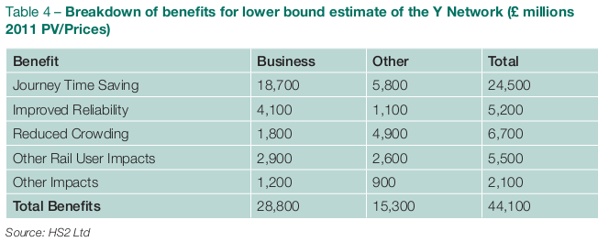
Sources of benefits

Slide 15
Concerns in the basic economic case
Value of business travel time savings
Impacts on behaviour
Price and congestion effects
Have we captured all the longer-term impacts allowing for relocation and agglomeration effects?
New (but controversial) approaches based on labour market and business connectivity suggest greater regional and national impacts

Slide 16
GDP Impact of connectivity
Maximum estimated impacts
Source: HS2: Regional Economic Impact, 2013

Slide 17
Regional distribution of estimated gains
Source: HS2: Regional Economic Impact, 2013

Slide 18
Redistribution of economic output in 2037
Source: HS2: Regional Economic Impact, 2013

Slide 19
Can these gains be realised?
Evidence suggests such gains are not automatic from high-speed rail
Service levels
  Frequency of service – problems for intermediate stations
  Pricing policies – use of yield management?
  Advance reservation?
Accompanying policies
  Transport links
  Land-use and urban planning
  Station development
Some evidence from Kent

Slide 20
The French case
Integrated network with use of existing stations and regional services off HSR network
Early success with TGV Sud-Est, later lines increasingly less profitable
Clear reference to regional development in Schéma Directeur
Mixed success of intermediate stations depending on supporting policies
Importance of integration in larger cities (e.g. Lyon, Lille)

Slide 21
French evidence – variations between predicted and observed traffic
^{(On entry into service)}
^{(In full operation)}

Slide 22
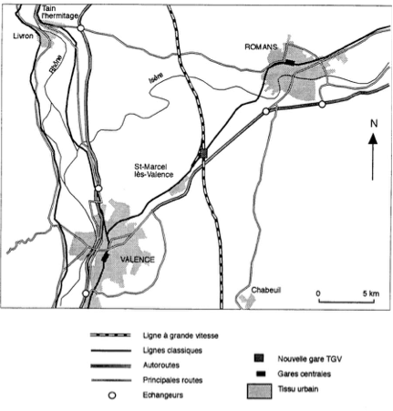
French evidence – a success story, Valence

Slide 23
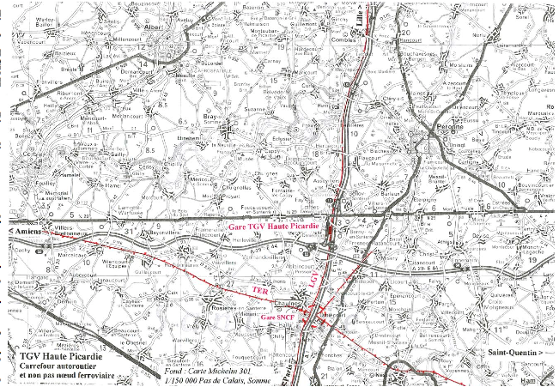
French evidence – an isolated station, TGV Haute Picardie

Slide 24
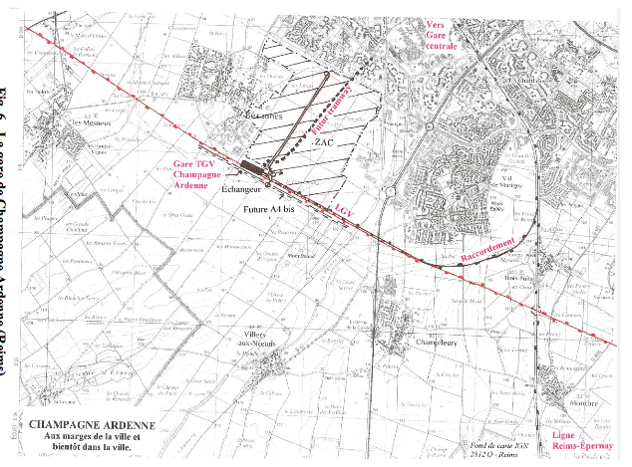
French evidence – an integrated periurban station, Champagne Ardennes

Slide 25
French evidence - some conclusions
Existing stations
  Reinforce connections with the classic rail network and urban public transport
  Remodel the interiors and exteriors of stations
  Develop public transport access at stations
  Provide adequate services at stations
  Develop a human presence at stations
New stations
  Need for connection with the classic rail network
  Preference for central locations over peripheral ones
  Integration between local networks and the HSR network – HSR stations are not airports but an integral part of the regional transport network

Slide 26
Changes in specialisation index in NW Europe
Core cities
Hinterlands
Krugman Specialisation Index
Source: Cheng, Loo and Vickerman, 2015

Slide 27
Impact of HS1 on Kent
Mix of international and regional services
Similar levels of traffic (ca.10mn) on each
Lack of coordinated development around Kent stations – compare Stratford
Problems of ex post analysis
  GVA at local level
  Changes in skill base
Economic development impact limited – commuting rather than inward investment
HS1 not transforming at regional level, but clear local impacts

Slide 28
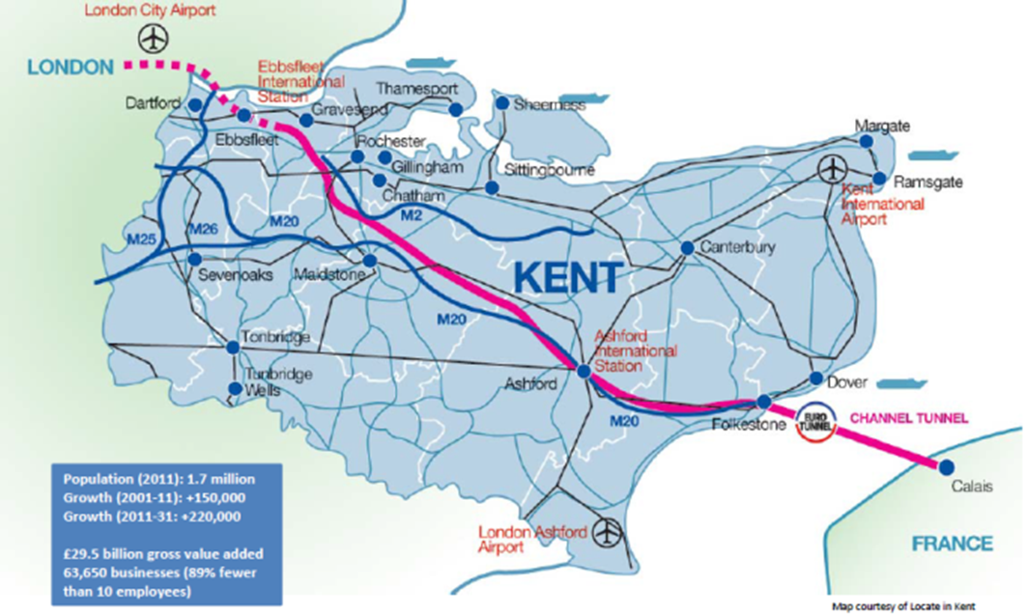
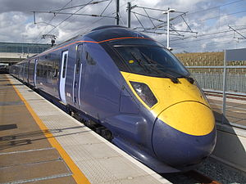
HS1 in Kent

Slide 29
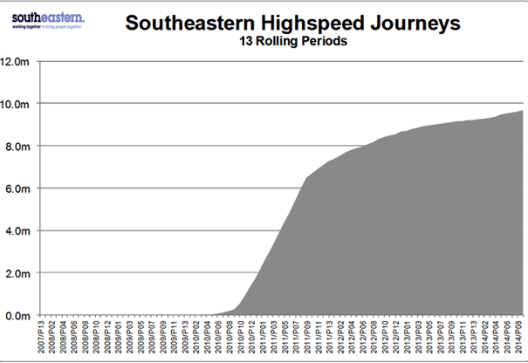
HS1 evidence – Domestic traffic

Slide 30
Changes in GVA, 1998=100
Source: Kent County Council

Slide 31
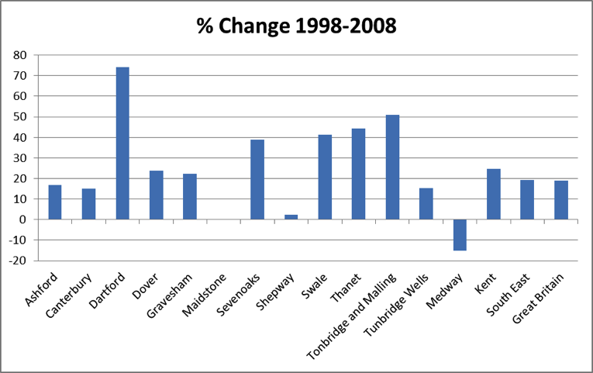
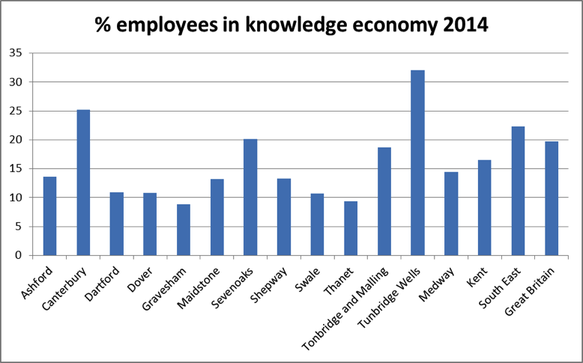
Employment in the knowledge economy
Source: Kent County Council

Slide 32
Issues raised
Forecasting long-distance trip making over long periods
  Assumptions about economic growth
  Assumptions about business travel behaviour
  Assumptions about non-business travel behaviour
Values of in-vehicle time savings – is business travel over-valued?
Assumptions on fare structures and price elasticities
Have we got the wider benefits right?
  Is agglomeration different in an inter-urban context?
  Effects of connecting cities
  Skill specialisation
Does the UK over-analyse – paralysis by analysis?
  Allowing for optimism bias
  How much risk should be left in?

Slide 33
Concluding thoughts
Realities and perception in the investment for growth argument
So can transport rebalance the economy?
But can the economy be rebalanced without investment in transport?
What are the outstanding issues?
  Accessibility and connectivity
  Cities versus wider regions
How do we compare local/regional improvements with major national multi-billion investments?

Slide 34
Thank you

