Slide 1
High Speed Rail for Central Europe? Tomeš, Z. – Jandová, M. – Seidenglanz, D.
INSTITUTE
FOR TRANSPORT ECONOMICS,
GEOGRAPHY AND POLICY

Slide 2
Motivation

Slide 3
European x national strategies
European strategy → promotion of TEN network; to establish the key links to facilitate transport in the EU; international focus
National strategies → to connect main centres of economic activity within one country; domestic regional and political issues; national focus

Slide 4
Aim
The aim of the paper is to rank potential HSR connections in Central Europe.

Slide 5
Methodology
Ranking methodology based on Todorovich – Hagler (2009) and Guirao – Campa (2014). The five main categories of variables to determine the value of Ranking Index to score the corridors in order to evaluate their HSR potential:
population size
origin-destination distance
economic vitality
urban transit connections
congestion

Slide 6
Ranking results (1) – U.S. HSR phasing plan
Source: Todorovich and Hagler (2009)

Slide 7
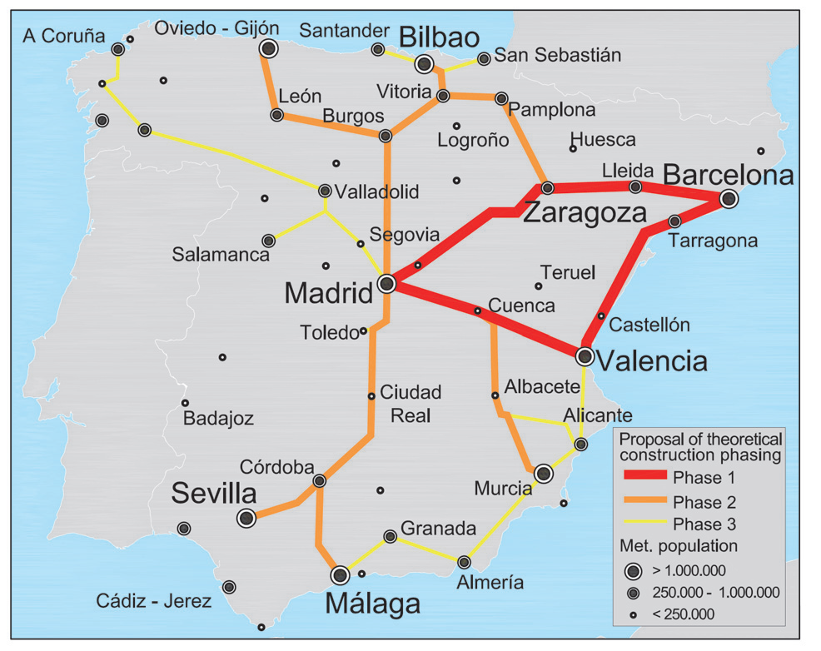
Ranking results (2) – HSR Spain
Proposal for a theoretical construction phasing
based on the modelling results
Current Spanish HSR lines in operation
with their year of opening
Source: Guirao and Campa (2014)

Slide 8
Our approach (1)
To include 10 international cross connections between capital cities: (Berlin, Prague, Warszawa, Wien, Budapest)
To include 10 most important national connections:
Warszawa → Lodz, Katowice, Krakow, Wroclaw, Poznan
Prague → Brno, Ostrava
Budapest → Gyor, Debrecen
Berlin → Dresden

Slide 9
Our approach (2)
Simpified methodology → only three out of five factors taken into consideration (population, economy, distance)
Ranking Index = $\frac{P1P2E1E2}{D}$
P1; P2 …… Metropolitan population size in origin and destination city
E1; E2 …… GDP p.c. in origin and destination city
D ……. Distance between origin and destination city

Slide 10
Ranking results
International connections National connections
1. | Wien - Berlin | 3.07
2. | Prague - Berlin | 2.94
3. | Prague - Wien | 2.60
4. | Budapest - Wien | 2.52
5. | Warszawa - Berlin | 1.85
6. | Warszawa - Wien | 1.36
7. | Budapest – Berlin | 1.00
8. | Prague – Warszawa | 0.75
9. | Prague - Budapest | 0.63
10. | Budapest - Warszawa | 0.59
1. | Dresden - Berlin | 2.85
2. | Warszawa – Katowice | 0.81
3. | Warszawa – Lodz | 0.67
4. | Prague - Brno | 0.54
5. | Warszawa – Krakow | 0.44
6. | Warszawa – Poznan | 0.43
7. | Warszawa – Wroclaw | 0.34
8. | Prague - Ostrava | 0.34
9. | Budapest – Debrecen | 0,10
10. | Budapest - Gyor | 0.04

Slide 11
International line and national network

Slide 12
Direct daily sevices 2016 (air, rail, bus)
International connections National connections
 |  | RI | Air | Rail | Bus
1. | Wien - Berlin | 3.07 | 12 | 1 | 8
2. | Prague - Berlin | 2.94 | 2 | 8 | 21
3. | Prague - Wien | 2.60 | 5 | 8 | 23
4. | Budapest - Wien | 2.52 | 3 | 13 | 9
5. | Warszawa - Berlin | 1.85 | 3 | 4 | 7
6. | Warszawa - Wien | 1.36 | 5 | 3 | 3.
7. | Budapest – Berlin | 1.00 | 4 | 2 | 2
8. | Prague – Warszawa | 0.75 | 8 | 3 | 2
9. | Prague - Budapest | 0.63 | 4 | 7 | 11
10. | Budapest - Warszawa | 0.59 | 5 | 2 | 0
 |  | RI | Air | Rail | Bus
1. | Dresden - Berlin | 2.85 | 0 | 8 | 30
2. | Warszawa – Katowice | 0.81 | 2 | 19 | 3.
3. | Warszawa – Lodz | 0.67 | 0 | 21 | 25
4. | Prague - Brno | 0.54 | 0 | 34 | 66
5. | Warszawa – Krakow | 0.44 | 7 | 22 | 20
6. | Warszawa – Poznan | 0.43 | 4 | 16 | 7
7. | Warszawa – Wroclaw | 0.34 | 8 | 13 | 15
8. | Prague - Ostrava | 0.34 | 2 | 33 | 0
9. | Budapest – Debrecen | 0,10 | 0 | 32 | 0
10. | Budapest - Gyor | 0.04 | 0 | 44 | 1

Slide 13
Discussion
Ranking Index parameters
Different costs of HSR build-up in lowlands and hills
Connection of main centres x intermediate stations
Links to Germany
CBA results

Slide 14
Conclusions
Based on our ranking exercise, two prospective HSR projects have emerged:
International line: Berlin – Dresden – Prague – Brno – Wien – Bratislava – Gyor – Budapest
National network: Warsawa – Krakow/Katowice
Warsawa – Lodz – Wroclaw/Poznan

Slide 15
Thank you!

